Slide 1
SpeedHaul Logistics Data Analysis & Dashboard
Presented by: Priscilla Koramah
Date: 27 October 2025
Dataset provided by SpeedHaul Logistics (simulation)

Slide 2
Executive Summary & KPIs (Actual Data)
Total Deliveries: 100
On-Time Deliveries: 65 (65.0%)
Average Delivery Time (hrs): 3.57
Average Client Satisfaction (1-5): 3.71
Total Fuel Cost (GHS): 35760
Average Packages per Trip: 42.1

Slide 3
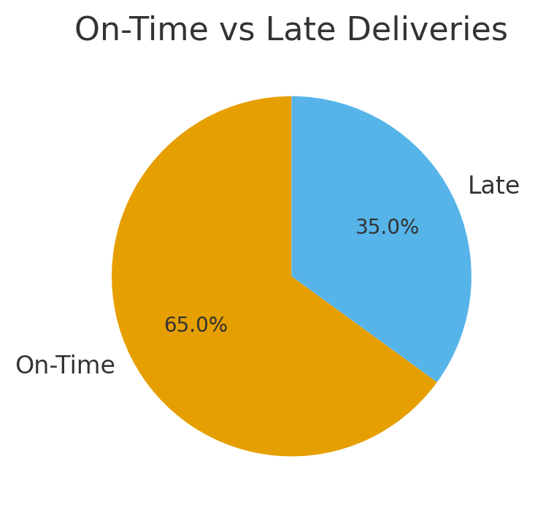
On-Time vs Late Deliveries

Slide 4
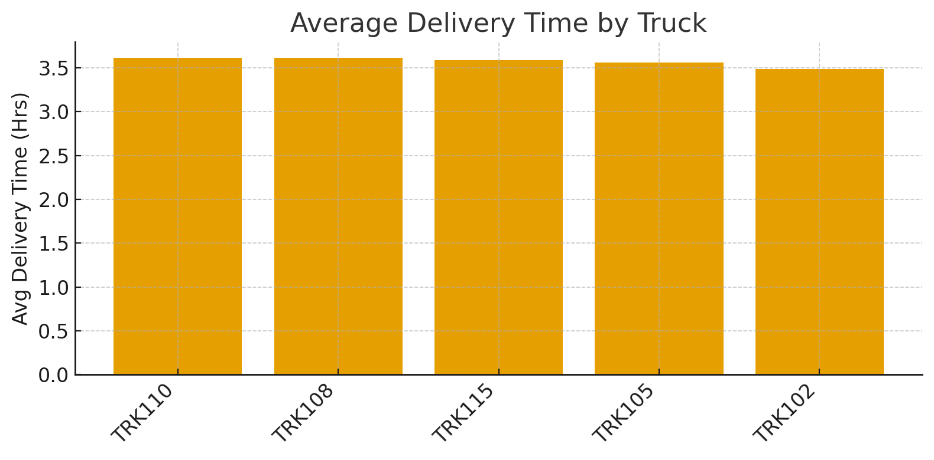
Average Delivery Time by Truck

Slide 5
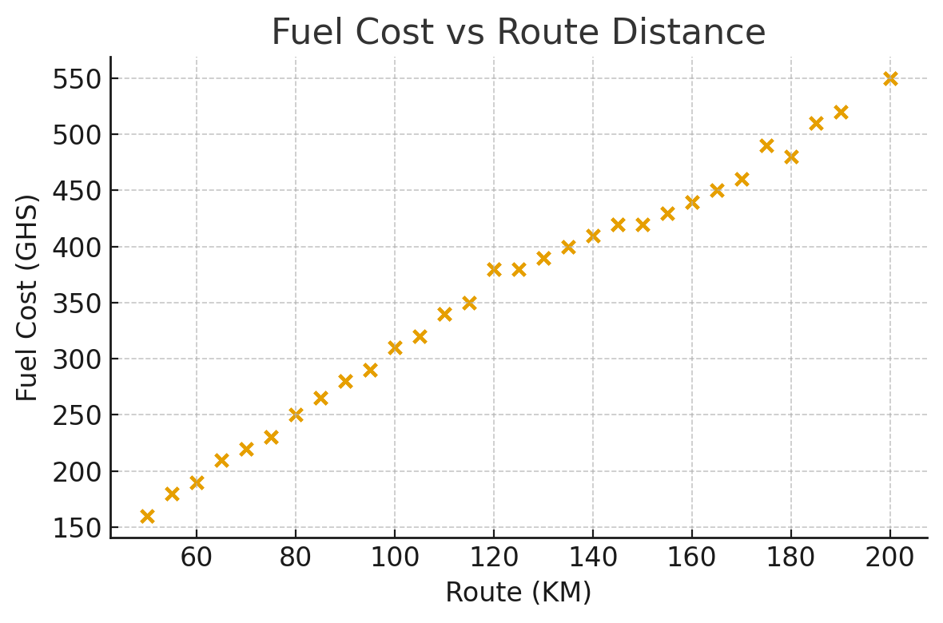
Fuel Cost vs Route Distance

Slide 6
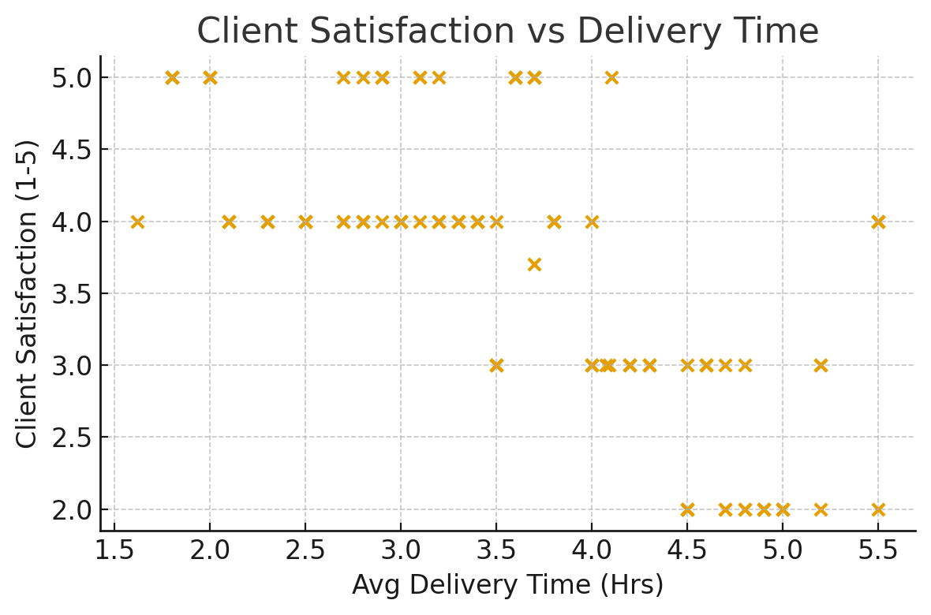
Client Satisfaction vs Delivery Time

Slide 7
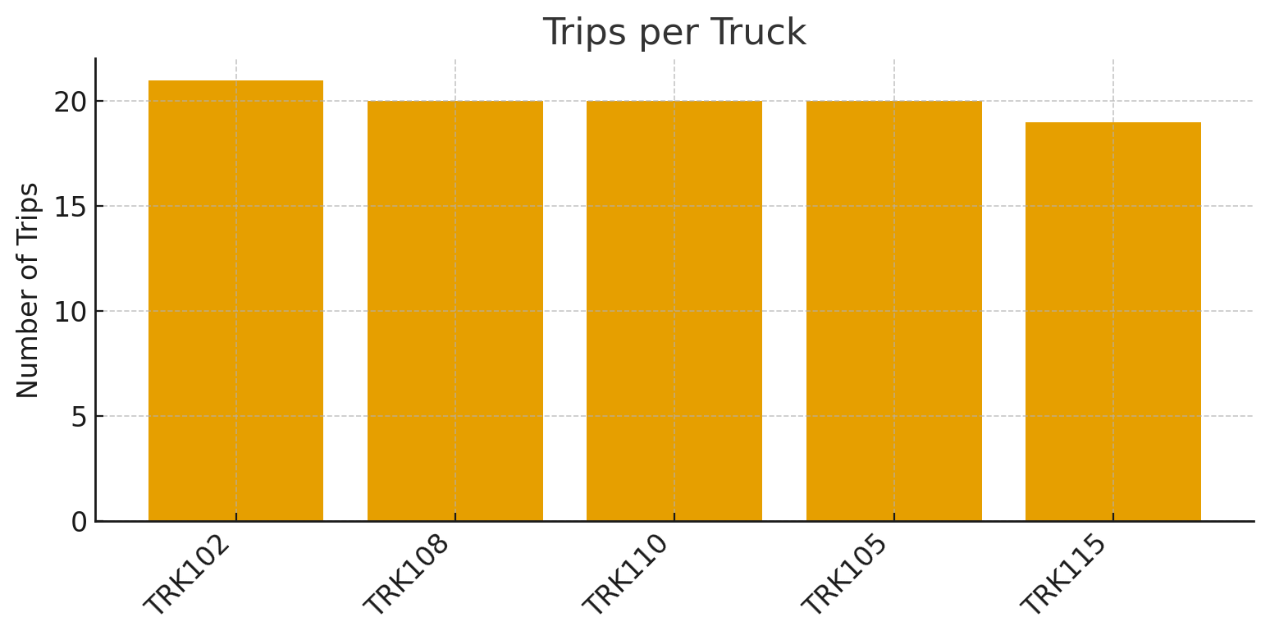
Fleet Utilization: Trips per Truck

Slide 8
Key Insights & Recommendations
On-time rate is 65.0% , target 90%. Focus on busiest routes to improve punctuality.
Average delivery time is 3.57 hrs; deliveries >4 hrs correlate with lower satisfaction.
Fuel cost increases with route distance - route optimization can cut costs.
Some trucks (see Trips per Truck) are over-utilized; rebalance assignments and schedule maintenance.
Recommendations: Implement route optimization, real-time tracking, and a Power BI dashboard for operational KPIs.

Slide 9
THANK YOU
Any Questions?

